Slide 1

EMOTION DETECTION FROM TEXT
Student: Ishan Ray Chaudhuri
Guide: Himanshu Souda

Slide 2
OVERVIEW
This is a machine learning project for classifying emotions from social-media text. It classifies input sentences into emotions like joy, anger, sadness, fear, and surprise.
Tools and Technologies Used:
• Python
• Streamlit
• Google Colab
• GitHub

Slide 3
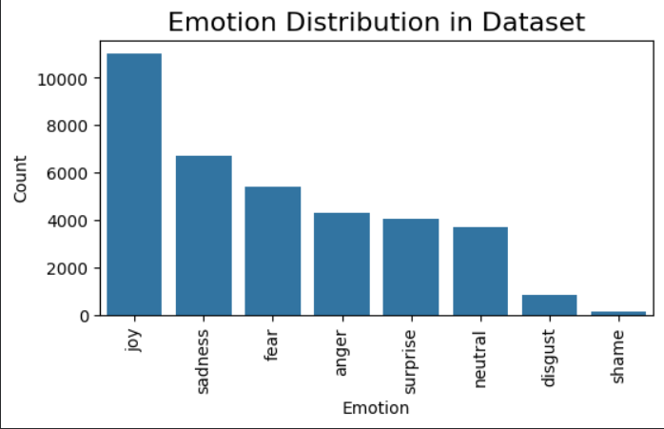
DATASET USED
An open source dataset from Kaggle was chosen at first with following parameters:
Issues:
  Highly imbalanced.
  Minor classes with too few samples (“disgust”, “shame”).

Slide 4
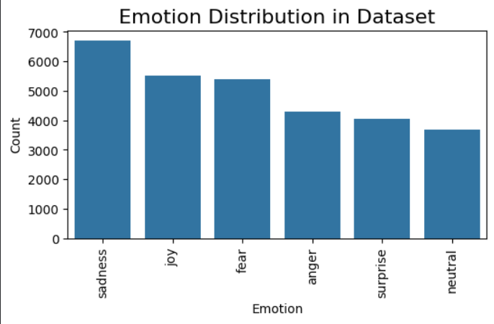
DATASET CLEANING
Steps taken:
  Removed under-represented labels:
– Removed shame and disgust due to insufficient samples.
  Balanced dominant label:
– Randomly sampled 50% of 'joy' (~5.5K samples) to reduce dominance.
Outcome: More reliable and fair training distribution.

Slide 5
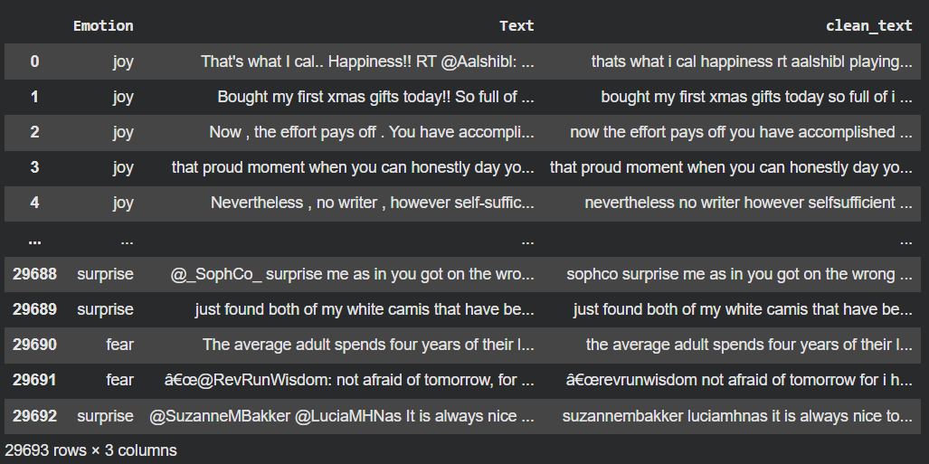
TEXT PREPROCESSING
Preprocessing applied to all text inputs:
  Convert to lowercase
  Remove URLs
  Remove numbers
  Remove punctuation
  Normalize whitespace
  Generate clean_text column
Clean text → better embeddings → better model performance.

Slide 6
END-TO-END MODEL WORKFLOW
  Prepared and formatted the dataset for training
  Tokenized text so the model can understand it
  Fine-tuned the RoBERTa base model on 6 emotion categories
  Achieved ~70% accuracy in identifying emotions from text

Slide 7
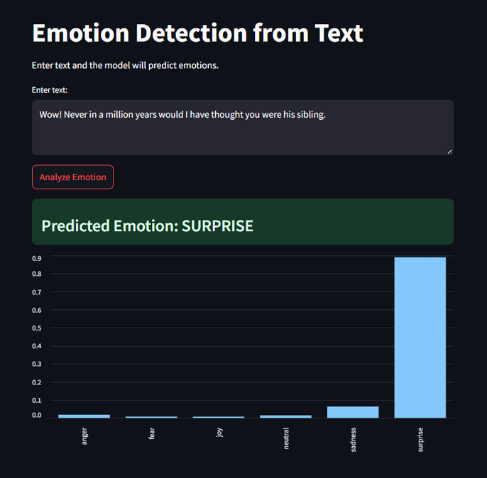
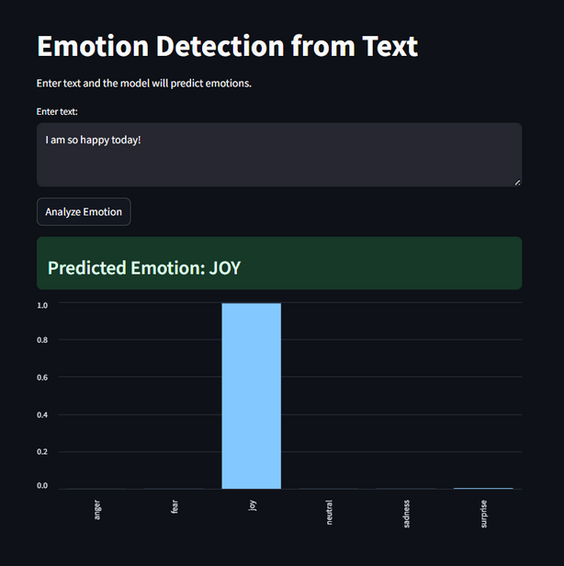
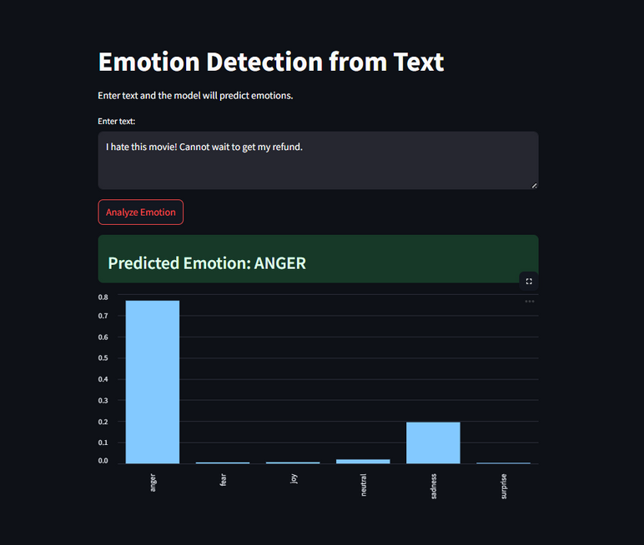
PROJECT WORKING
The model loads, processes input text, and outputs the predicted emotion with confidence to user through streamlit.

Slide 8
APPLICATIONS
  Customer support sentiment analysis
  Social media monitoring
  Emotion-aware chatbots
  Feedback analytics
  Content moderation (flagging toxic or emotional posts)
  Email prioritization (identify urgent or emotionally intense messages)

Slide 9
FUTURE SCOPE
• Deploy as full web app/API
• Multilingual support
• Better more diverse datasets
• Real-time chat emotion tracking
• Visual dashboards

Slide 10
THANK YOU
GitHub:
https://github.com/Ishan-R-C/IBM_Project

